Slide 1
West Yorkshire and Harrogate Health and Care Partnership Reaching Our Ambition: WY&H a trauma informed and responsive system by 2030
June 2021
Carrie Rae and Emm Irving
#AdversityTraumaResilienceWYH
https://westyorkshireknowledgeexchange.co.uk/

Slide 2
West Yorkshire and Harrogate
Health and Care Partnership
Stronger Together

Slide 3
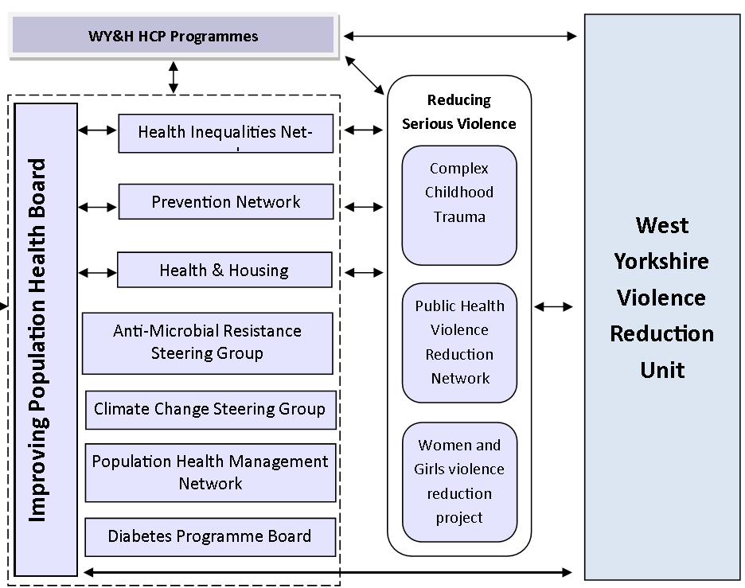
West Yorkshire VRU & WY&H Health & Care Partnership
Shared Vision & Principles
Embedding a Public Health Approach
System Leadership, Governance & Connectivity
National NHSE/W Blue Print
Joint working with WY&H HCP Programmes
Knowledge, Data & Insight
Covid-19 Response & Public Health Networks
Joint commissioning &Programme Delivery
Tri – Service PH Consensus & Framework
Public Health Planning & Evaluation Toolkit
WHATS NEXT…..

Slide 4
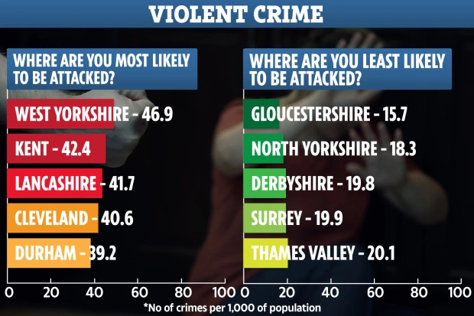
West Yorkshire Violence Reduction Unit
There has been a 93% rise in UK hospital admissions for knife attacks on under-16s since 2012
West Yorkshire tops the list, with the county's police force noting residents are most at risk of being a victim of violent attacks, robbery, sex offences, damage to property and theft of property.
The county recorded 107.6 violent attacks per 1,000 people in the 12 months before June 2019.
A public health approach to violence recognises that
violence is a preventable problem requiring a societal response

Slide 5
West Yorkshire Violence Reduction Unit
Needs Assessment 2021
Knife Crime, Crimes of Violence against the Person and Gun Crime have all been identified as a serious issue in West Yorkshire.
Operation Jemlock, the bespoke response to serious violent crime, has seen over 5,100 arrests with 4,730 stop and searches being made. Over 600 offensive weapons have also been seized.
42% of knife crime offenders are males aged between 15 and 24.
94% of gun crime offenders and 99% of victims are male, with those aged 20-24 the most common offenders.
Most knife and gun crime offences occur in areas of high deprivation.
Domestic abuse- 76,000 incidents were recorded in the most recent monitoring period.
Females account for 75% of victims and two-thirds of victims are aged 20-39. Suspects were mainly male (75%), with two-thirds being aged 21-40.
Violence with Injury offences occur more regularly in town and city wards, with peaks in offending from 23:00 to 00:00, suggesting a link with increased footfall around the night time economy.
100% of homicide offenders in West Yorkshire were aged between 15 and 24.

Slide 6
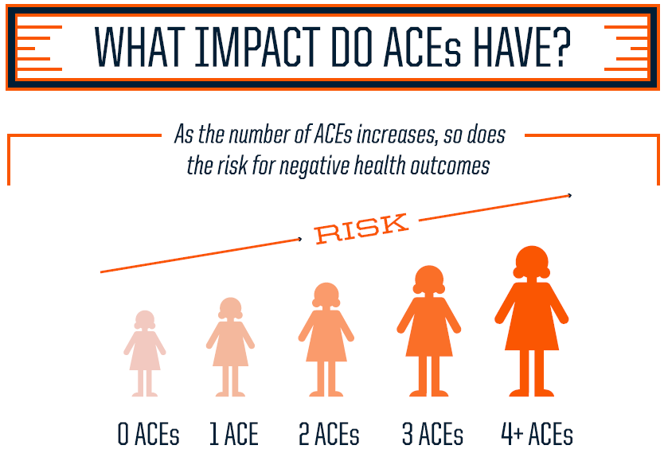
Source: http://www.rwjf.org/aces

Slide 7
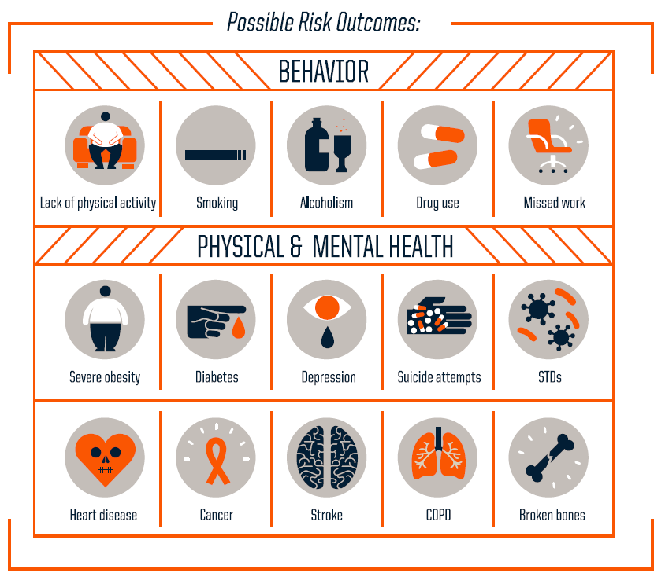
Source: http://www.rwjf.org/aces

Slide 8
Spoken word piece describing the impacts of child sexual exploitation and child criminal exploitation
CREST recruited youth ambassadors, Kemmi and Isha met with discuss how they wanted to contribute to the project, after discussing the project aims with Crest, they decided that they wanted to use their creativity to explain the impact of criminal and sexual exploitation of young people.
The youth ambassadors decided to write a spoken word piece and an accompanying video to express their feelings on how violence and exploitation impacts themselves and other young people in their area.
The young people who created the video described to us that they wanted to “subvert traditional gender stereotypes by focusing the narrative on a young boy who has been sexually exploited and a young girl who has been criminally exploited.”
Through this piece, the youth ambassadors tell a different story than the data; they believe that there are young people in their area who are being exploited under the radar. It is therefore essential to listen to local stakeholders to understand their experiences rather than simply relying on the data to speak for them.

Slide 9
Reaching Our Ambition: Our Vision
Working together with people with lived experience and colleagues across all sectors, organisations to ensure WY&H is a trauma informed and responsive system by 2030.

Slide 10
What do we mean by a trauma Informed and responsive system
A multi-system trauma-informed approach refers to a coordinated, cross-system strategy that has aligned policies, practices, and services for supporting and building resilience.
Strategic leadership and champions embedded across the system
Looking beyond individual professions, services and organisations
Embedding the evidence and knowledge of trauma and adversity across all sectors & organisations
recognising and responding to the needs of the workforce (particularly those repeatedly responding to trauma).
Collaboration across all sectors to provide accessible and appropriate services,
Empower individuals to engage fully in their care, make informed choices and develop trusting relationships.
Continuous self assessment and review of all trauma informed organisations
Empower and promote awareness with and for communities
Engage in efforts to strengthen assets, resilience and protective factors of children, families and adults, impacted by adversity and trauma
“People who have experienced trauma are not condemned to a life of hopelessness and helplessness. People can, and do, recover from trauma.”

Slide 11
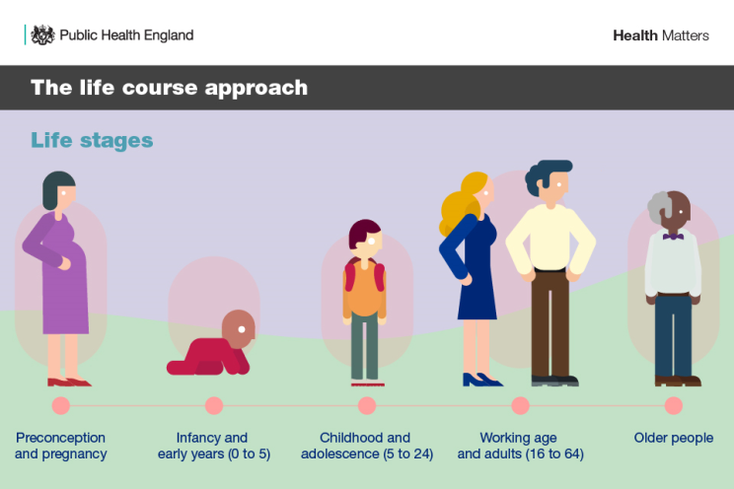
Reaching Our Ambition
Prevention and Early Intervention
The 2020s will be the decade of proactive, predictive, and personalised prevention
Advancing our health: prevention in the 2020s : July 2019
A Life Course Approach
Safe, stable, environments,
Healthy housing,
Financial security,
Trusting relationships,
Access to support and reducing stigma for adults facing multiple disadvantages such as substance misuse, depression and roughsleeping.
https://twitter.com/hashtag/TheBrainStory?src=hashtag_click

Slide 12
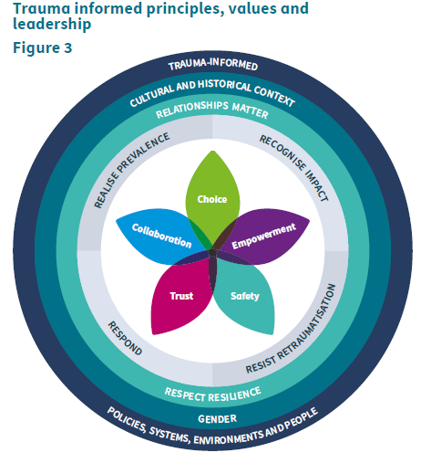
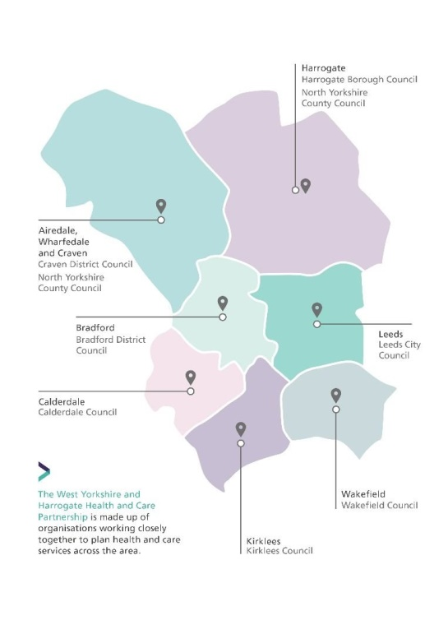
Reaching Our Ambition
learning from each other and being better together
Harnessing good practice to feed into local strategies; learning from Scotland
Trauma-informed organisations are those that embed the principles of safety, trustworthiness, choice, collaboration and empowerment into all aspects of their work and commit to ensuring that physical environments, staff behaviour and organisational policies and procedures reflect trauma-informed principles and systems

Slide 13
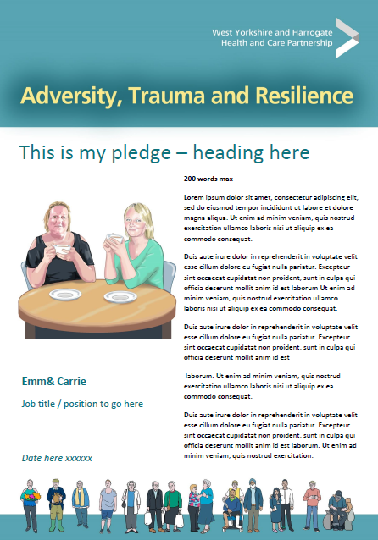
Reaching Our Ambition:
System Leadership
Bring system leaders together to discuss complexity of trauma and adversity and commit to system actions, ambitions and change
All stakeholders learn and share together: system mapping, shared understanding, ambitions, influencing, generating new ideas, insight and collaboration
SYSTEM CHAMPIONS

Slide 14
Progress to date
Developed links with Experts in the field
National networks and communities of practice
Commissioned Humankind: Changing Systems Project
Established WY Steering Group
System Leadership Support
July 2020
Sep 2020
Nov 2020
Feb 2021
April2021
Aug 2020
Oct 2020
Jan 2021
March2021
Agreed WY Ambition
System Workshop with steering group
LA Chief Executive Lead agreed
WY Adversity, Trauma & Resilience Knowledge Exchange

Slide 15
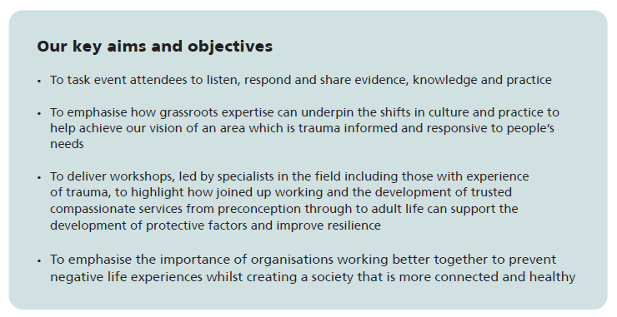
WY&H Adversity, Trauma and Resilience Knowledge Exchange
https://westyorkshireknowledgeexchange.co.uk/

Slide 16
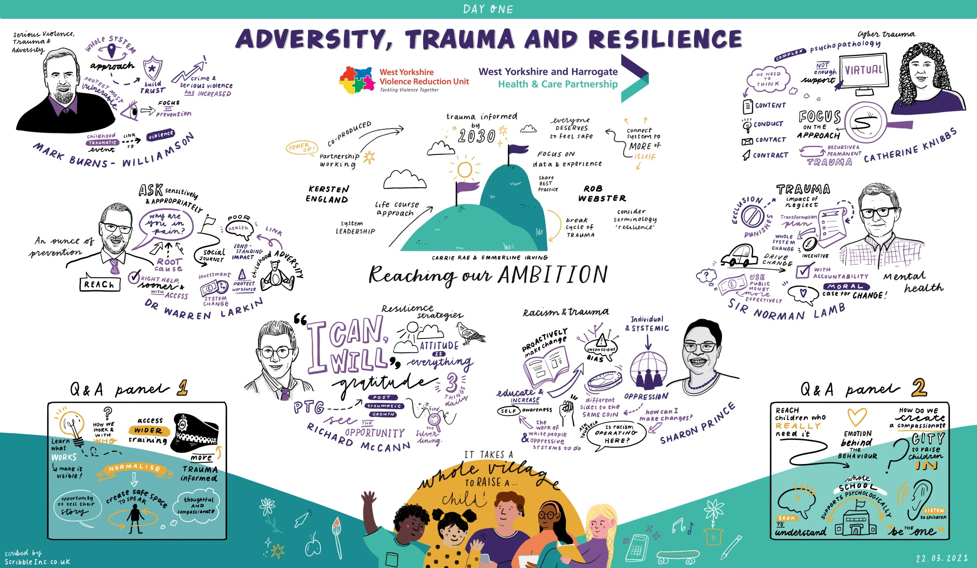
WY&H Adversity, Trauma and Resilience Knowledge Exchange
https://westyorkshireknowledgeexchange.co.uk/

Slide 17
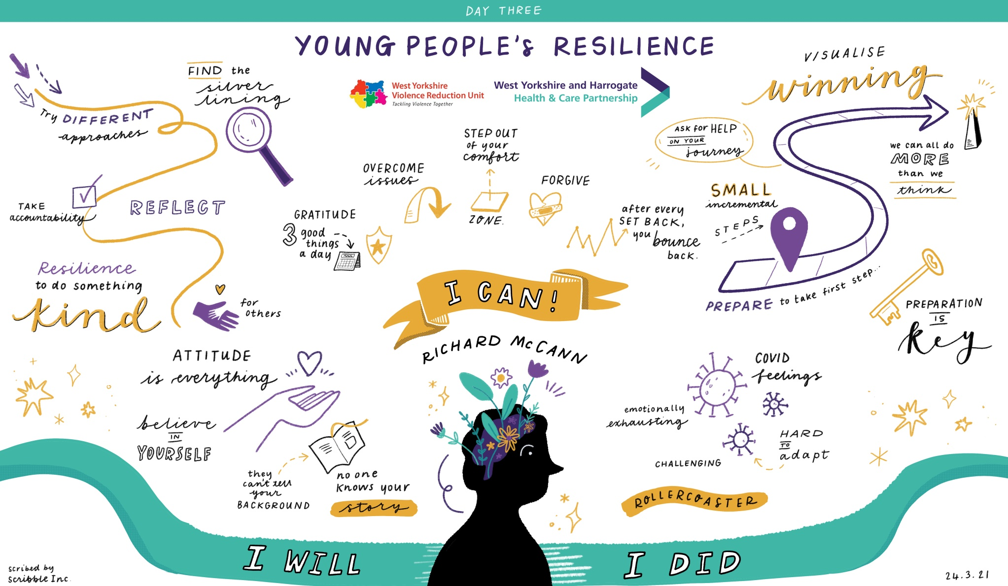
WY&H Adversity, Trauma and Resilience Knowledge Exchange
https://westyorkshireknowledgeexchange.co.uk/

Slide 18
WY&H Adversity, Trauma and Resilience Knowledge Exchange
https://westyorkshireknowledgeexchange.co.uk/

Slide 19
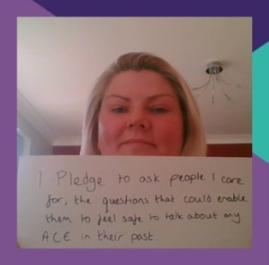
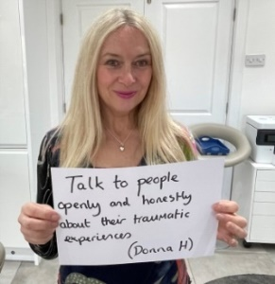
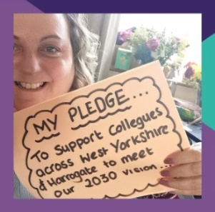
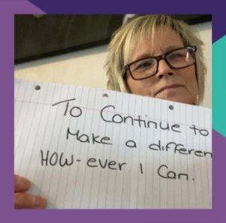
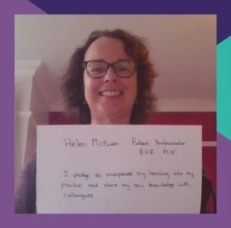
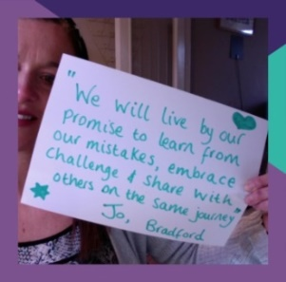
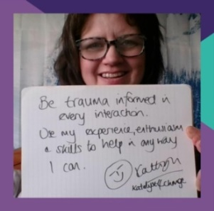
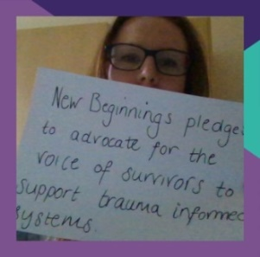
Reaching Our Ambition: Say ‘Cheese’ and make a pledge
There is still time to
make a pledge

Slide 20
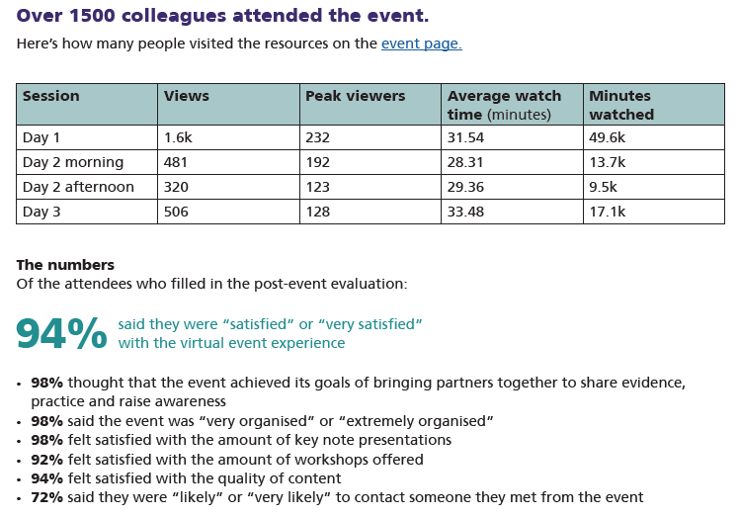
WY&H Adversity, Trauma and Resilience Knowledge Exchange
https://westyorkshireknowledgeexchange.co.uk/

Slide 21
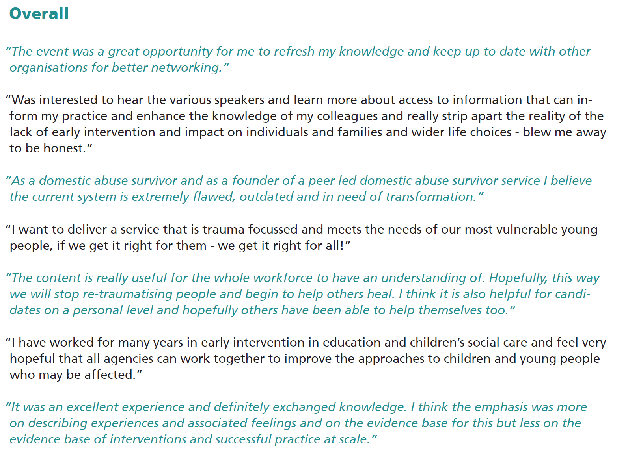
WY&H Adversity, Trauma and Resilience Knowledge Exchange
https://westyorkshireknowledgeexchange.co.uk/

Slide 22
Reaching Our Ambition: Next Steps
Changing Systems Project
Health and Justice Expression of Interest: Framework for Community Integrated Care
Home Office and Youth Endowment Foundation Funding: Trauma Informed Training
Adversity, Trauma and Resilience Programme Structure
System Champions & Case Studies
Involvement, Engagement and Co-production Plan and Events
WY&H Trauma Informed and Responsive Strategy 2022 – 2030
Present at local Health & Wellbeing Boards
System Leadership workshop
Inclusion in JSNAs

